Slide 1
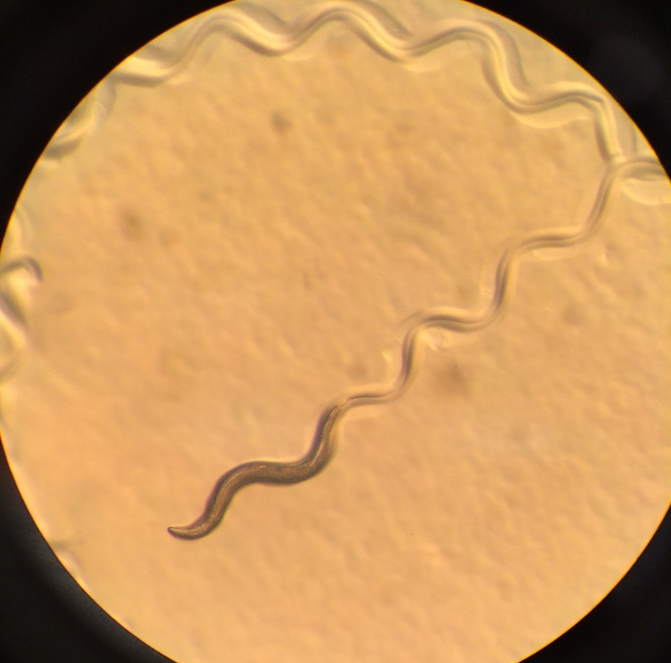
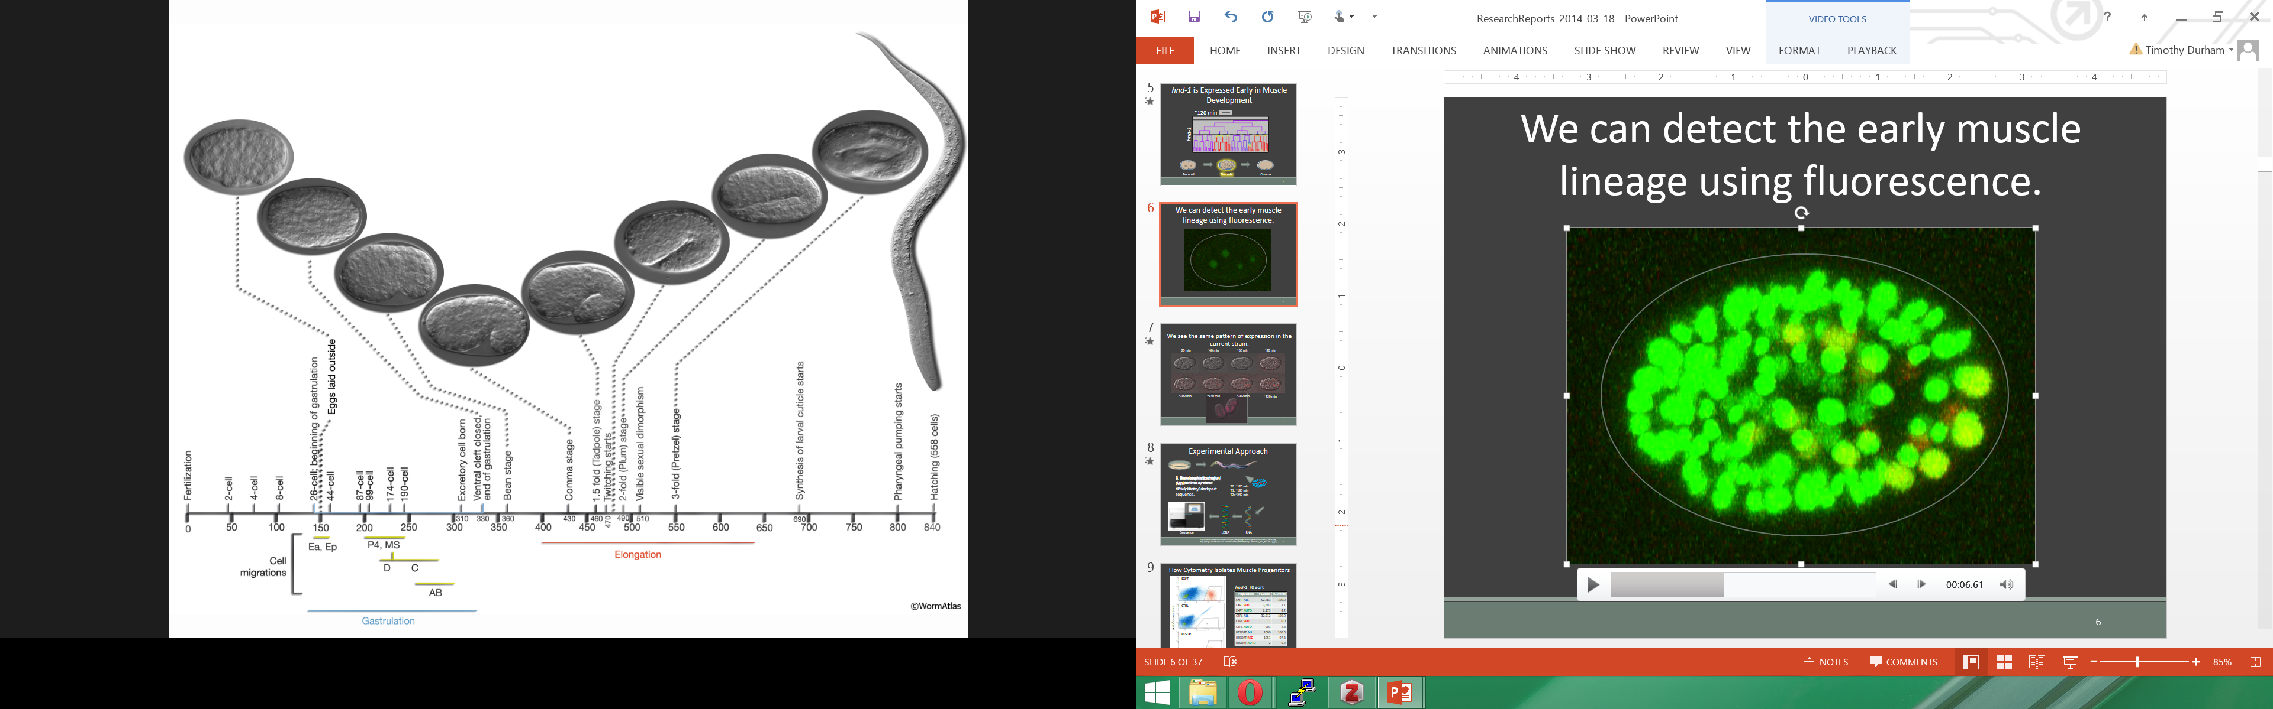
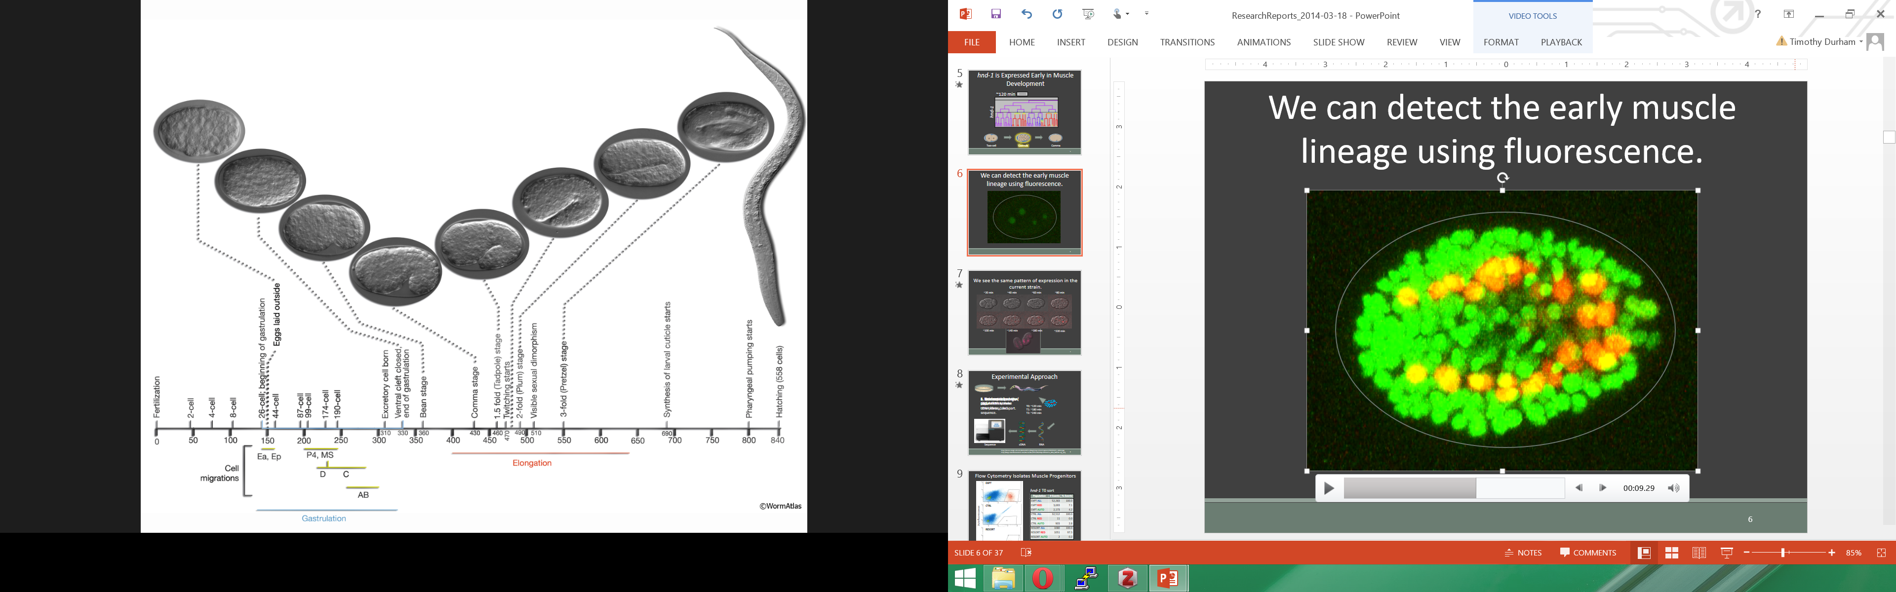
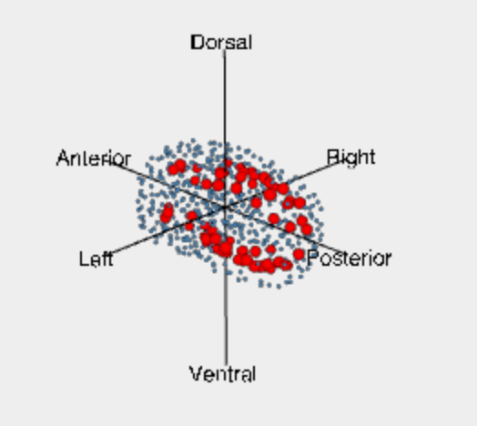
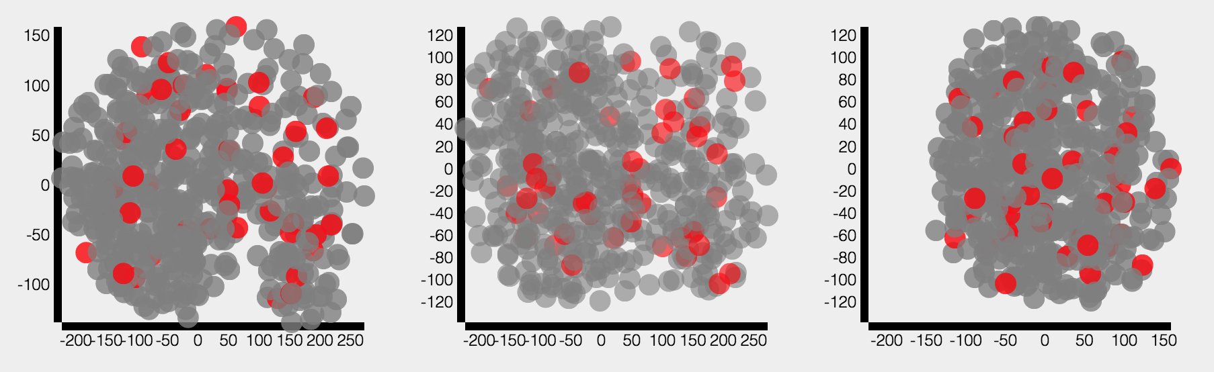
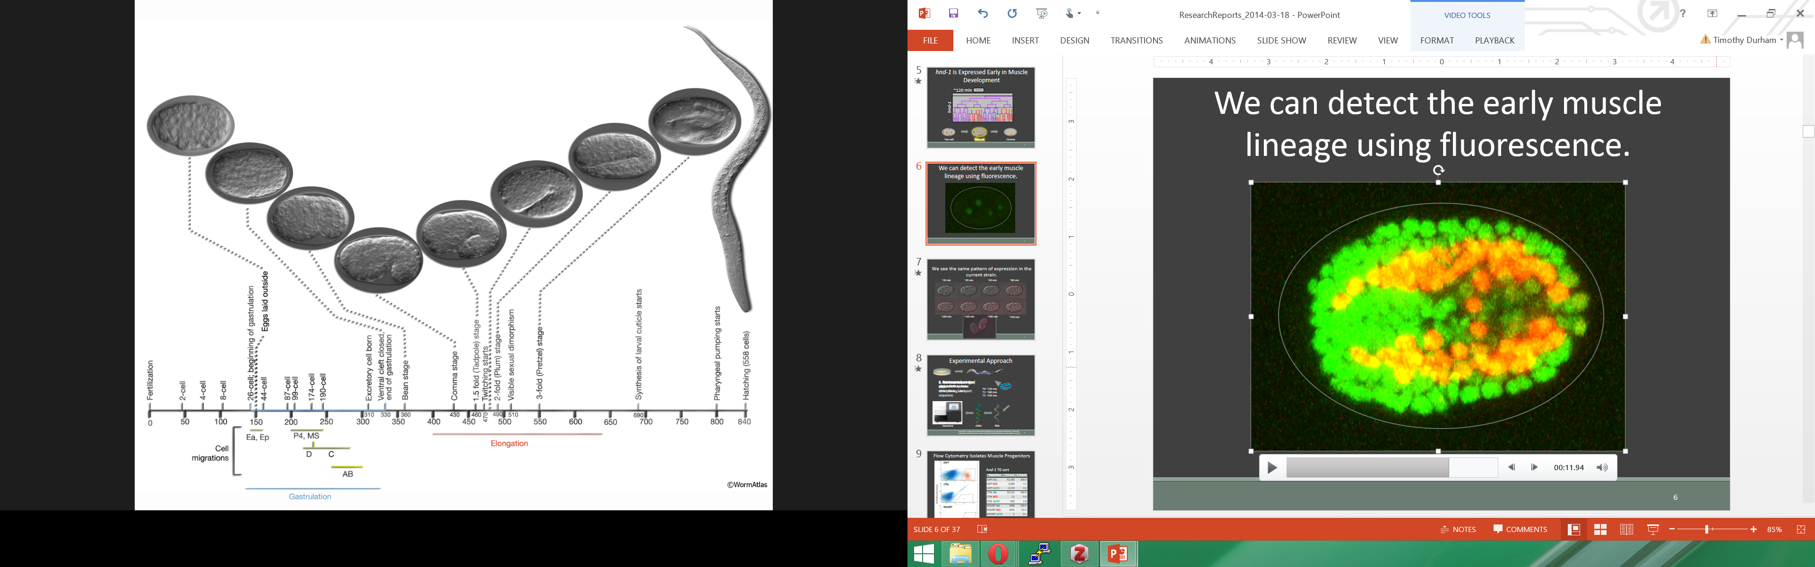
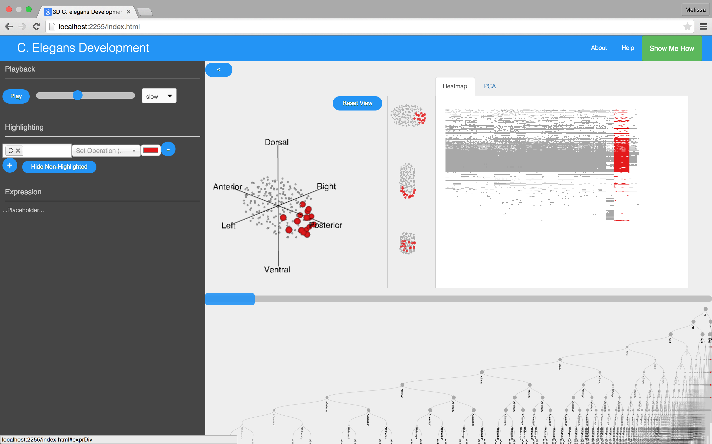
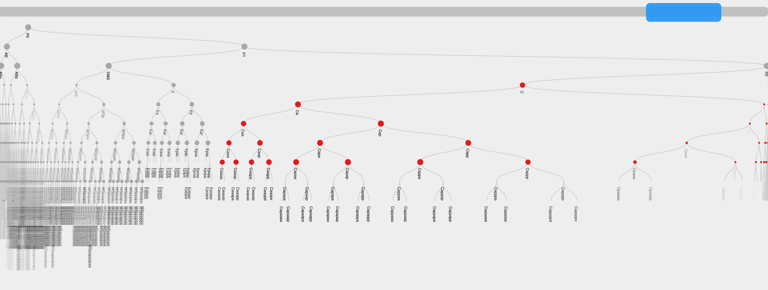
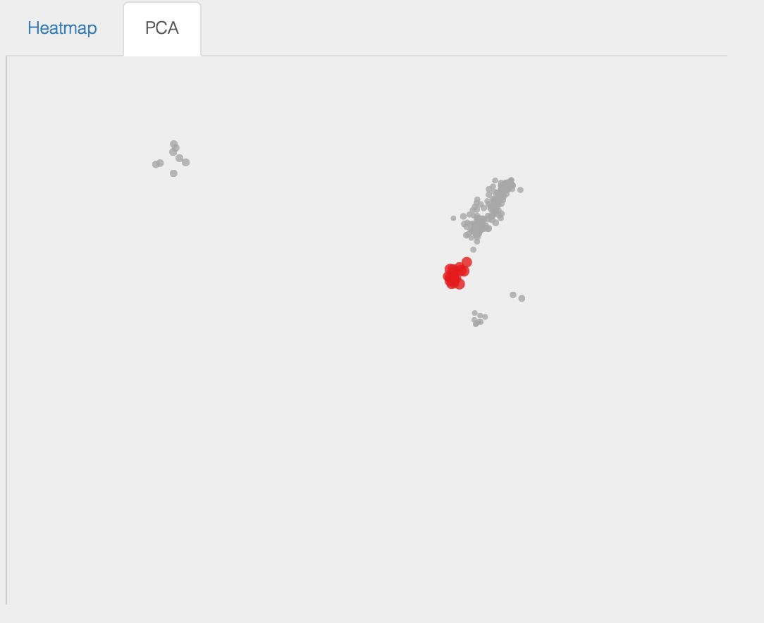
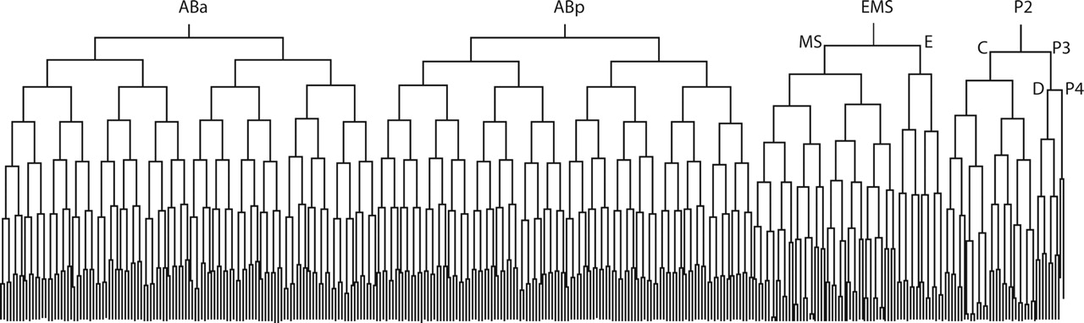
EPICViz : An interactive C. elegans embryogenesis and gene expression visualization
Melissa Chiasson¹, Timothy Durham¹, Andrew Hill¹, Ning Li²
¹Department of Genome Sciences, ²Department of Statistics
C. elegans and gene regulation
Caenorhabditis elegans (C. elegans) is a small roundworm used widely as a model organism in genetics and genomics. Each worm takes around 14 hours to grow from a single fertilized cell to a hatched larvae with 558 cells.
Embryonic development proceeds due to the tightly choreographed expression of several genes. These patterns of gene expression contribute to cell identity.
Location of cells during embryogenesis is also important, as cell-cell interactions can influence gene regulation.
An adult C. elegans specimen.
Dataset
Features
Based on user selection, specific lineages and cell types can be highlighted in color.
The user can track development in 3D and in 2D small multiple projections.
Genes of interest can be selected from the heat map for further study.
The Expression Patterns In C. elegans (EPIC – http://epic2.gs.washington.edu/Epic2) project has generated a dataset that describes the spatial orientation of every cell during C. elegans embryogenesis, its developmental lineage and cell fate, and expression measurements for a set of about 227 genes.
These data provide an expansive view of gene expression in the C. elegans embryo; however, to derive insights into gene expression patterns in different cells across time we need a tool to integrate and allow interactive exploration of the data.
Expression of hnd-1, a muscle-specific gene, through development.
Preliminary study of 3D plot with 2D small multiples.
Types of data
Results
Spatial orientation and diameter of cells
Cell types and lineages
Gene expression for ~250 genes in each cell
A screenshot of our visualization with the “C” cell lineage highlighted in red.
Approach and Design
We sought to address this lack of resource by developing an interactive visualization that includes a 3D plot of the C. elegans developing embryo, a lineage tree that is synched to the 3D plot, and plots of gene expression patterns. Users can explore the data using filters for lineage, cell type, and time point.
Highlighting can be tracked in the lineage tree (left panel). In addition to a heatmap of gene expression, shown in the screenshot above, we added a PCA plot of cells based on their gene expression patterns (right panel).
About
Help
Show me how
a)
b)
y
d)
A prototype of our visualization. We strived to combine a) user selections for cell lineage, cell type, and gene expression, b) a 3D plot of embryo development, c) small multiple projections of that 3D plot, d) a heat map of gene expression values, and e) the lineage tree.
Playback
z
Gene 1
Gene 6
Gene 2
Gene 3
Gene 4
Highlighting
slow
x
Gene 5
Future Work
Cell lineage or cell type
Lineage tree nodes
+
Hide non-highlighted
Expression
c)
Gene name or function
+
y
x
z
x
y
z
0%
100%
Expand logical control of selections
Add selection criteria for gene function
Display histogram of expression among lineages upon selection in heatmap or PCA plot
e)

